Slide 1

Spoiled Beverage Detector
Jahangir Esfandiari (ID: 217834)
Bahar Rahmani (ID: 218192)
Kymbat Talant (ID: 203235)
Vanessa Mathew (ID: 217957)
Notes:
A very good afternoon to everyone….. For our group, we will be presenting on the topic of “Spoiled Beverage Detectot”
And these are our group members

Slide 2
Outline
Introduction/Objective
Early Findings (Properties of Fruit Juices and Milk)
Current Technologies
Functions and structures
Possible Solutions : Option 1 (Gas sensor)
Possible Solutions : Option 2 (pH meter)
Complete design status
Demonstration
Evaluation/Conclusion
Notes:
This is a brief outline of what we will be presenting today …

Slide 3
Introduction/Objective
Consuming Expired Drinks
Effect: Stomach cramp, fever, vomiting, nausea, diarrhea, etc
Detecting spoilage takes time
Children not aware of the early signs of expired drinks
Objective: Smart cup to detect expired drinks and display accurate results fast.
Notes:
Problems:
Often, we hear children getting sick from consuming expired drinks. This can be due to the fact that children are not fully aware of the early signs of expired drinks.
As a result of food poisoning, they experience a variety of problems such as stomach cramp, fever, vomiting, nausea and diarrhea.
Time it takes to detect spoilage is long. For example: in order to find out if the milk is gone bad, boiling is an option which takes time and consumes energy.
- Read Objective Statement
- With this, not only a multitude of problems associated with drinking expired beverages can be avoided, but also it can prevent discarding of the drinks that were presumed to be expired.

Slide 4
Early Findings: Fruit Juices Property
Fruit juices have pH in the acidic range (<4.5) becomes conducive for bacterial growth
Freshly squeezed juice, is highly susceptible to spoilage more than whole fruit
Juices | pH range | Mean
Orange | 4.19–4.50 | 4.34
Sweet lime | 4.70–5.47 | 5.08
Carrot | 5.76–6.03 | 5.89
Table 1: PH level of different fruit juices [4]
Notes:
From this table, we can see the different pH values of different types of juices
As we know, the pH value of fruit juices lie in a wide range of between 6 – 4 and especially for juices with a pH level lower than 4.5, becomes conducive for microbial growth
And this is also especially true for squeezed juice as they are more susceptible for spoilage than whole fruit

Slide 5
Early Findings: Critical factors affecting the spoilage of juices
Intrinsic | Extrinsic
Juice pH | Storage temperatures and times
Water activity | Relative humidity conditions during storage and packaging material characteristics.
Table 2: Intrinsic & Extrinsic Properties for Juice Spoilage [5]
Effects:
Development of off-flavors
CO2 production
Changes in color, texture, and appearance
Notes:
Here are some of the intrinsic (internal) and extrinsic(external) factors that affect fruit juice spoilage
Effects include: ….

Slide 6
Early Findings: Composition of cow‘s milk
The pH value of normal milk is in the range between 6.6-6.8 at 25°C
Main constituent | Limits of variation | Mean value
Water | 85.5 – 89.5 | 87.5
Total solids | 10.5 – 14.5 | 13.0
Fat | 2.5 – 6.0 | 3.9
Proteins | 2.9 – 5.0 | 3.4
Lactose | 3.6 – 5.5 | 4.8
Minerals | 0.6 – 0.9 | 0.8
Table 3: Quantitative composition of milk [6]
Notes:
As for milk the pH value lies in between …
Some of the main constituents of milk includes …

Slide 7
Early Findings: Different milk properties
Raw Milk | A wide variety of germs
Pasteurized Milk | Coxiella burnetti, Poreformers, Listeria Monocytogenes, Coliforms.
Condensed Milk | Glaucus, Aspergillus repens, Torulopsis.
Dried Milk | Bacillus, Micrococcus, Mucor
Table 4: Milk forms [7]

Slide 8
Early Findings: Fruit Juices + Milk Microorganisms
Microorganisms
Yeasts
Bacteria
Molds
Mycotoxins
Pathogens
Fruit juices contain a microflora which is normally present on the surface of fruits during harvest and postharvest processing which include transport, storage, and processing.
Common pathogens/bacteria seen both in milk and juice: Salmonella, E. coli., Pseudomonas
Notes:
There are a wide variety of microorganisms that are present both in spoiled milk and fruit juices, and the common similar pathogens/bacteria would be …

Slide 9
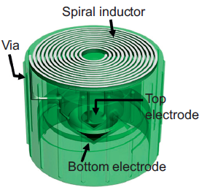
Current Technologies: Smart Cap
Sensing the quality of liquid in fluidic package
Based on changes in capacitance
Resonance frequency shifts of the LC tank via an inductive reader
LC tank as wireless-resonant sensor
Passive operation without power consumption
Fig.1. Design of a wireless “smart cap” [1]

Slide 10
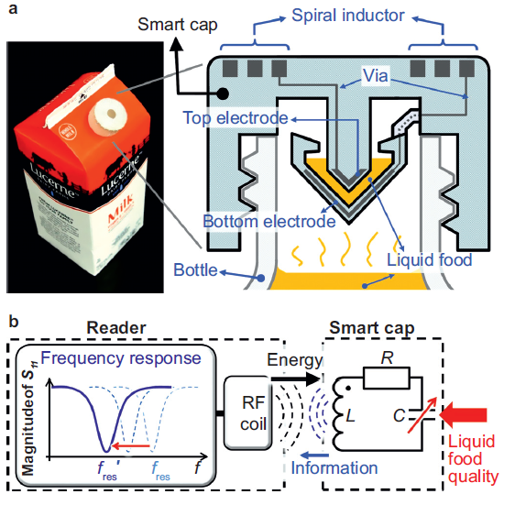
Current Technologies: Smart Cap (Design)
LC resonant circuit
Fig.2. (a) smart cap with milk package, (b) LC circuit diagram [1]
Notes:
By flipping the food package upside down. the liquid food is trapped inside the capacitor gap of the LC tank and acts as the dielectric
material. The LC tank’s fres, is determined by the dielectric constant of the liquid food.

Slide 11
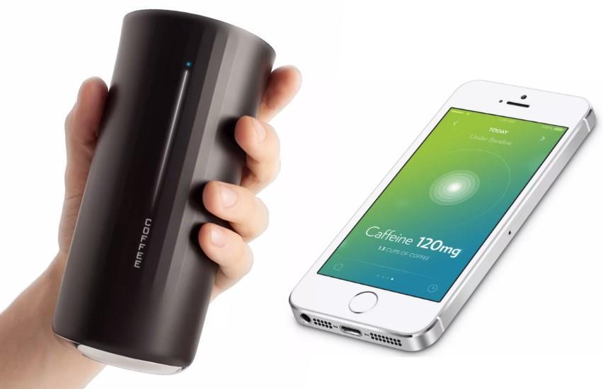
Current Technologies: Vessyl
Smart Cup → amount of liquid, type of beverage
Information on the side
Mobile app track every sip
Turns blue → Hydration
Only track water
Fig.3. Vessyl smart cup [2]

Slide 12
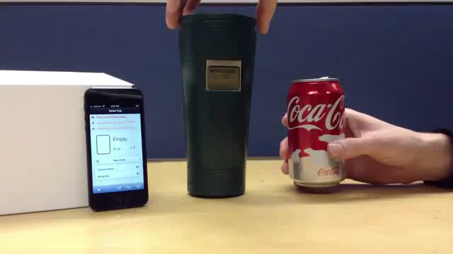
Current Technologies: Berkeley
Smart cup → track the consumption of common beverages
No detection of spoilage
LED on one side with sensor on the other side
Force resistor on the bottom of the cup
Wireless device in the base
App in mobile device

Slide 13
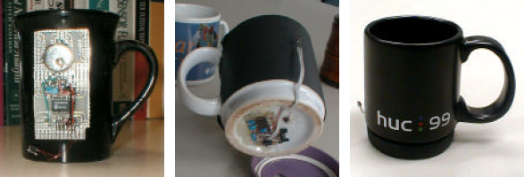
Current Technologies: Media Cup
Coffee Cup → Represent the context information: Location, Temperature
Components
Acceleration sensor
Microcontroller
Infrared diode
Lithium Battery
Semiconductor chip
Overhead Transceiver
Fig.4. Media cup Prototypes [3]
Notes:
first version→ for initial data collection but was not fit for day-to-day use.
second prototype→ embedded the MediaCup hardware at the bottom of a coffee cup.
third prototype → the hardware mounted in the rubber base of the HUC99 coffee cup, allowing removal so that the cup can be dishwashed.

Slide 14
Detection of Spoiled Milk
Selection of 1 type of drink to detect – Pasturized Milk
Easier to detect spoiled milk than spoiled juices
Spoiled juices have a wide range of pH value between different fruits
Health issues in third world countries
Human senses are often inadequate
Important nutrients for humans as wells as for animals
Notes:
- Throughout brain storming phase, the complexity involved to detect different kinds of drinks.
Therefore decided to narrow down the process to 1 type of drink: pasturized milk
Read points 1-3
And of course motivation to detect spoiled milk is also driven by : health issues in 3rd world countries, ….

Slide 15
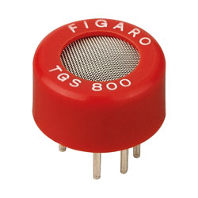
Option 1 Gas sensor
Use of a gas sensor TGS 800
Closed measuring chamber
Power Supply
Voltmeter
Fig.5. TGS 800 sensor [8]
Notes:
There were essentially 2 different possible solutions to this problem
The initial solution involved using the gas sensor to detect spoiled milk

Slide 16
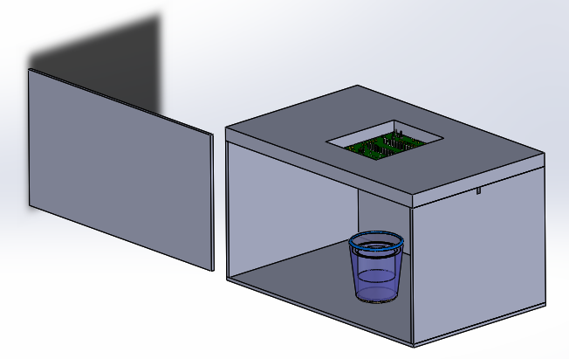
Option 1 Gas Sensor
Fig.6. Isometric View Enclosed Glass Box [9],[10]
Drawing assembled by Vanessa.M
Notes:
- This is a schematic of what it would have look like

Slide 17
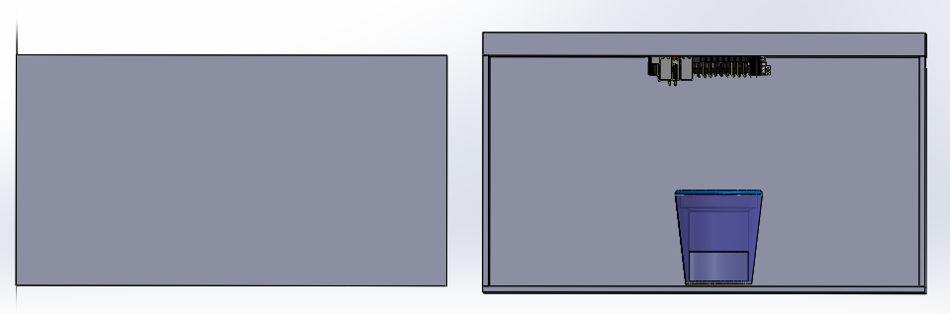
Option 1 Gas Sensor
Fig.7. Front View Enclosed Glass Box [9],[10]
Drawing assembled by Vanessa.M

Slide 18
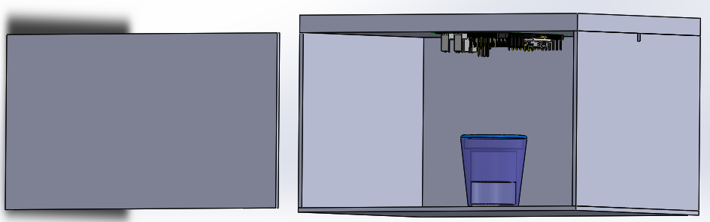
Option 1 Gas Sensor
Gas Sensors
Hole for Wiring
Polymer
Glass
Spoiled Milk
Fig.8.Detailed View Enclosed Glass Box [9],[10]
Drawing assembled by Vanessa.M
Notes:
Essentially you have an enclosed glass box with the cover made of polymer material
Top of the cover you have the sensors with the circuit board attached facing into the box to detect the spoiled milk, holes are built to allow for wiring connected to …
Initial step is to measure the voltage of healthy milk, then take it out and place in spoiled milk.
From there let the gas sensor detect it , and measure the final voltage of spoiled milk
- The difference of voltage represents spoiled milk
But because of the complexity of the set up and cost, we decided to go for an easier approach with the pH meter

Slide 19
Conclusion
Purpose/ practicality or ease of use
- Easy set up, insert pH probe into spoiled milk and stir
Functionality
- Detects sour milk with a pH level of lower than 6.6
Features
- Noise alert when pH level is lower than threshold
General aesthetics
- Needs to be further improved to include all components under one housing
Potential of marketability
- Could potentially be commercialized once made more portable
Notes:
- As a conclusion, we look back at the purpose of this prototype ..…….

Slide 20
Thank you for your attention!

Slide 21
References
[1] Sung-Yueh Wu et al. 3D-printed microelectronics for integrated circuitry and passive wireless sensors in Microsystems & Nanoengineering, USA,2015
[2] http://hiconsumption.com/2014/06/vessyl-smart-cup/
[3]Hans-W. Gellersen et al. The MediaCup: Awareness Technology embedded in an Everyday Object in Telecooperation office, Karlsruhe, Germany, 2001
[4] Alicyclobacillus spp. Control in the Fruit Juice Industry
[5] Microbiology of soft drinks and fruit juices (P. Wareing and R.R.) Davenport
[6] http://dairyprocessinghandbook.com/chapter/chemistry-milk
[7] Shinde Kajal P. et al IoT based detection of microbial activity in raw milk by using Intel Galileo Gen II in IRJET, india, 2017.
[8] https://ciiva.com/part/tgs-800-13645760
[9] https://grabcad.com/library/circuit-board-pcb-mock-example
[10] https://grabcad.com/library/agian-glass-1

